Slide 2
Days of School

Slide 95
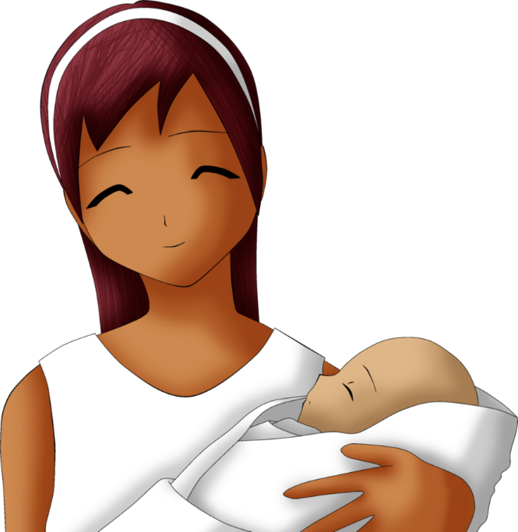
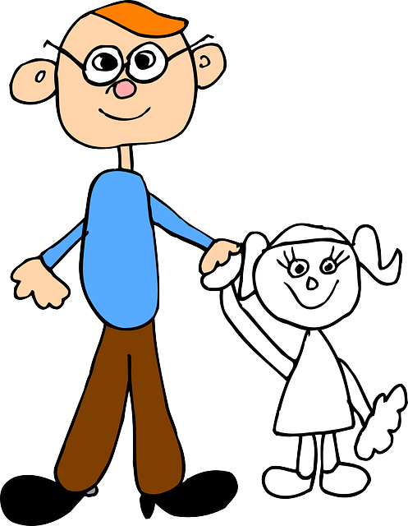
th
noisy
the

Slide 96
wr

Slide 97
qu

Slide 98
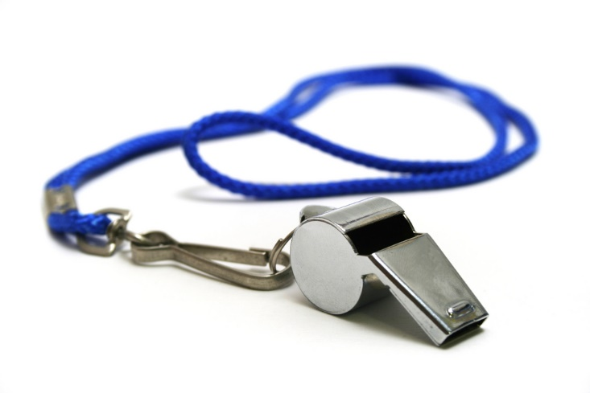
wh

Slide 99
kn

Slide 100
they

Slide 101
the

Slide 102
to

Slide 103
my

Slide 104
go

Slide 105
we

Slide 106
like

Slide 107
I

Slide 108
he

Slide 109
me

Slide 110
here

Slide 111
this

Slide 112
for

Slide 113
come

Slide 114
where

Slide 115
do

Slide 116
you

Slide 117
look

Slide 118
down

Slide 119
two

Slide 120
see

Slide 121
a

Slide 122
little

Slide 123
in

Slide 124
did

Slide 125
your

Slide 126
was

Slide 127
what

Slide 128
that

Slide 129
said

Slide 130
him

Slide 131
her

Slide 132
no

Slide 133
by

Slide 134
were

Slide 135
of

Slide 136
can

Slide 137
have

Slide 138
up

Slide 139
is

Slide 140
yes

Slide 141
and

Slide 142
it

Slide 143
are

Slide 144
with

Slide 145
be

Slide 146
one

Slide 147
we

Slide 148
want

Slide 149
out

Slide 150
who

Slide 151
she

Slide 152
good

Slide 153
there

Slide 162
Red Words

Slide 163
the

Slide 164
my

Slide 165
was

Slide 166
are

Slide 167
to

Slide 168
do

Slide 169
you

Slide 170
your

Slide 171
here

Slide 172
said

Slide 173
have

Slide 174
of

Slide 175
very

Slide 176
should

Slide 177
could

Slide 178
would

Slide 179
were

Slide 180
they

Slide 181
what

Slide 182
two

Slide 183
many

Slide 184
any

Slide 185
come

Slide 186
some

Slide 187
give

Slide 188
live

Slide 189
put

Slide 190
from

